Slide 1
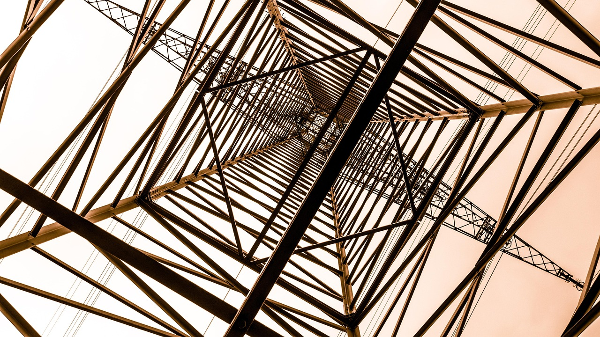

DESIGN
Materials Material Properties

Slide 2


IGCSE Product Design
Material Properties
DESIGN
Link to Full
Documentary

Slide 3
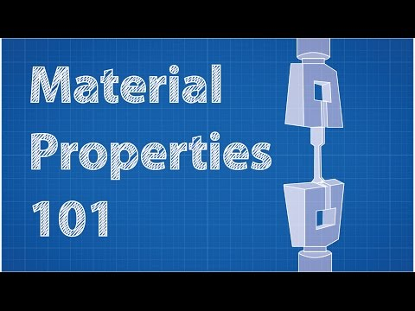
IGCSE Product Design
Material Properties
DESIGN

Slide 4

IGCSE Product Design
Material Working Properties
DESIGN
Strength
The ability to withstand a constant external force without failing

Slide 5
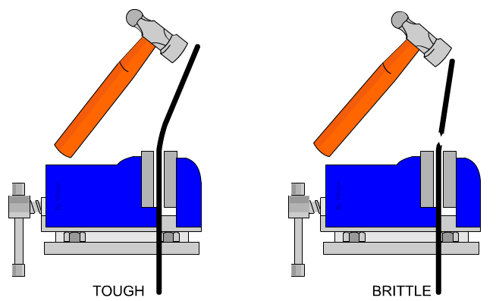

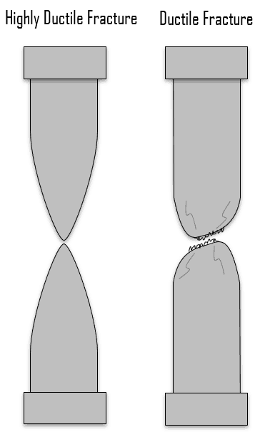
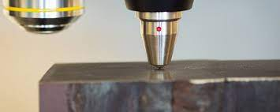
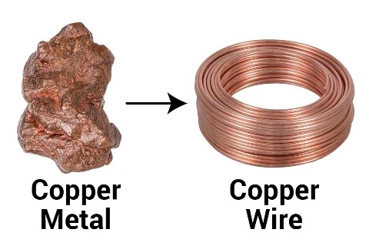
IGCSE Product Design
Material Working Properties
DESIGN
Hardness - Softness Hardness is a measure of how easily a material can be scratched or indented. Hard materials are often also very brittle - this means they have a low resistance to impact
Toughness Toughness is the ability of a material to absorb energy and plastically deform without fracturing
Brittleness 'Brittleness' describes the property of a material that fractures when subjected to stress but has little tendency to deform before rupture.
Ductility Ductility is a property that describes the ability of a material to stretch thin when tensile stress is applied. Significant plastic deformation occurs before the material ruptures or breaks.

Slide 6
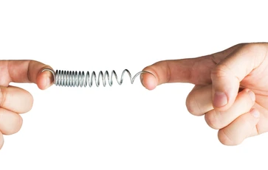
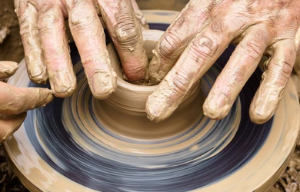
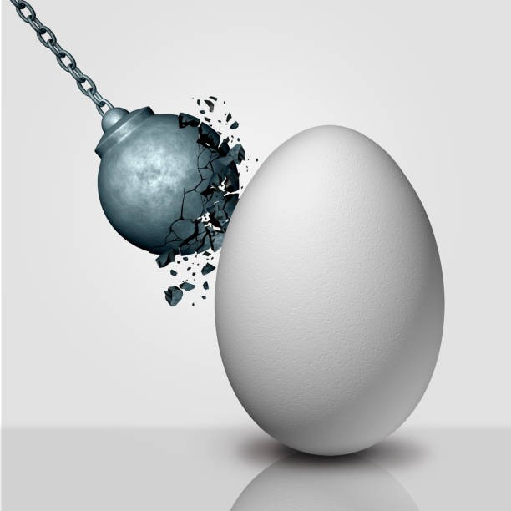
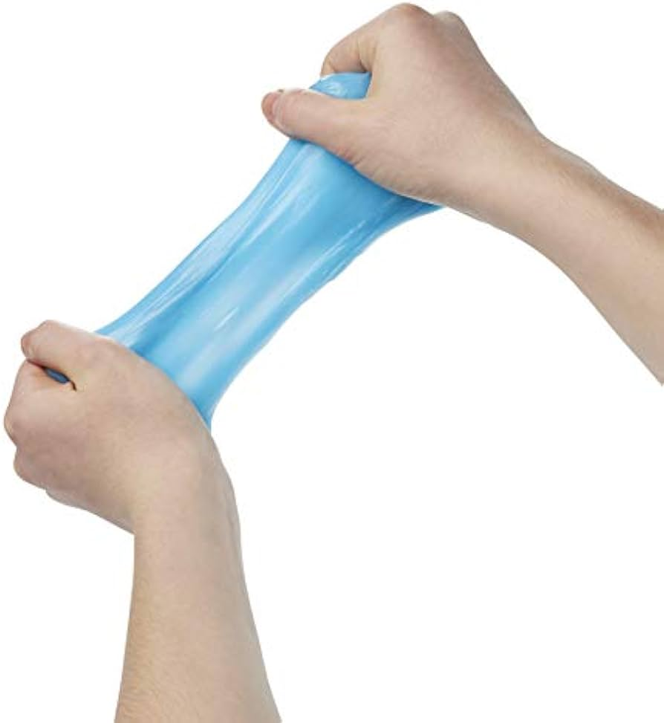
IGCSE Product Design
Material Working Properties
DESIGN
Malleability Malleability is the quality of something that can be shaped into something else without breaking. It is also a material that can be flattened into thin sheets by hammering or rolling.
Durability Durability is the materials ability to withstand wear, pressure, or damage. It is its ability of a material to remain serviceable in the surrounding environment during its useful life without damage.
Plasticity Plasticity is the ability to permanently change shape or form, which applies to materials other than polymers
Elasticity Elasticity is the ability to bend and then return to its original shape and size

Slide 7
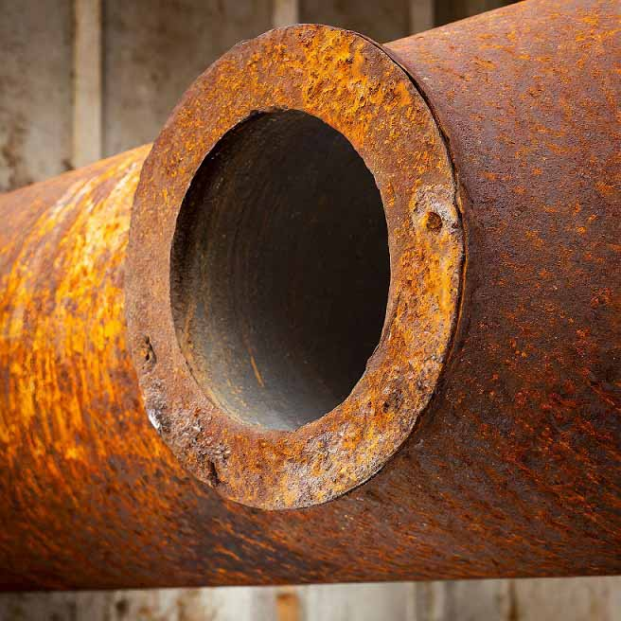
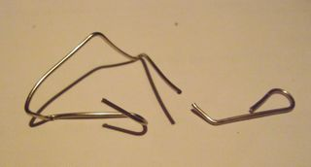
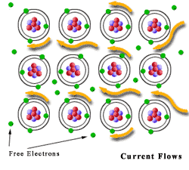
IGCSE Product Design
Material Physical Properties
DESIGN
Mechanical
How a material behaves/reacts when physical forces have been applied to it – becomes brittle when repeatedly bent
Chemical
How a material reacts to a chemical. Such as metal rusts or oxidises with water.
Electrical Conductor - Insulator Electrical conductivity is the measure of the ease at which an electric charge can pass through a material. An electrical conductor is a material which gives very little resistance to the flow of an electric current. | Thermal Conductor - Insulator Thermal conductivity is a materials property used to compare the heat-transfer ability of different materials.

Slide 8
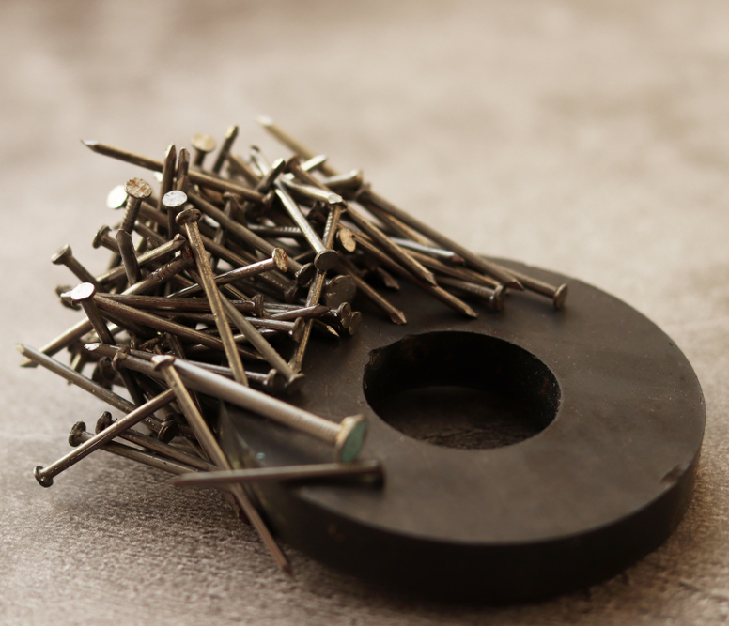
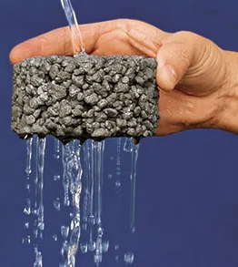
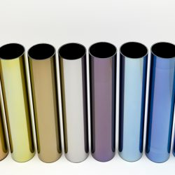
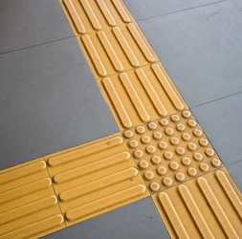
IGCSE Product Design
Material Physical Properties
DESIGN
Magnetic
A material that cains iron attracts to magnets or can be magnetised.
Permeability
The degree that a liquid or a gas can pass through a material
Aesthetic
The Visual sensory properties of the surface, shape, colour or shine of a material
Tactile
The touch or sensory properties of a material such as texture.

Slide 9
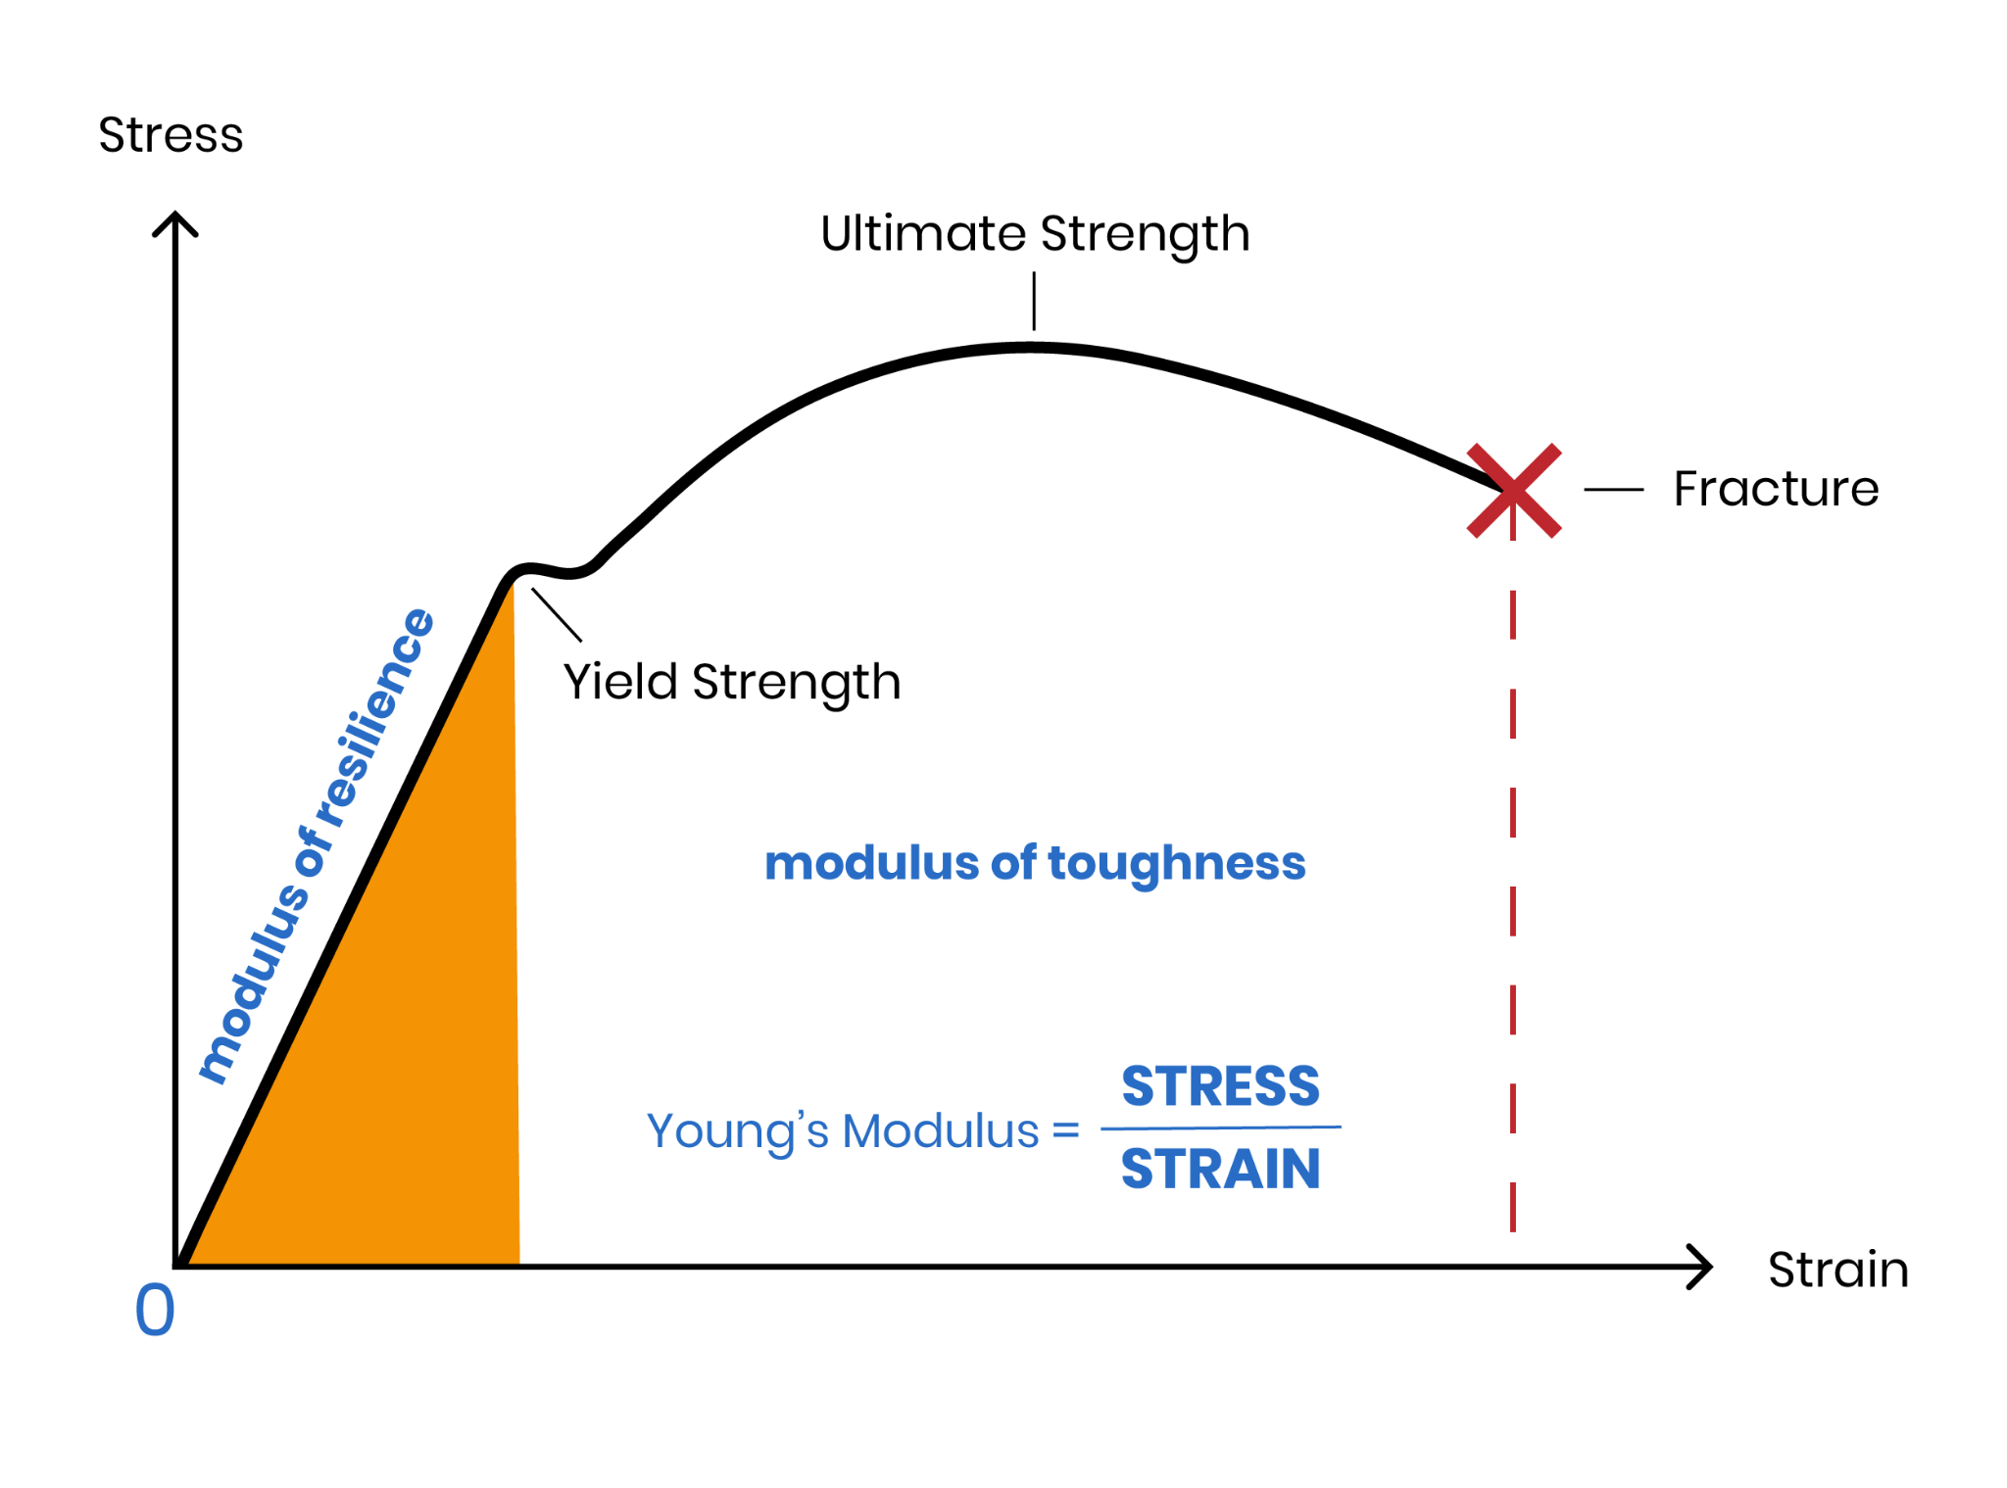
IGCSE Product Design
Material Properties
DESIGN
Stress is pressure (force per unit area) applied to a cross-section.
Strain is how much a solid deforms because of stress

Slide 10
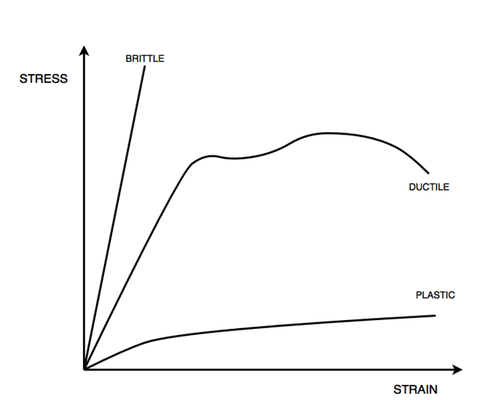
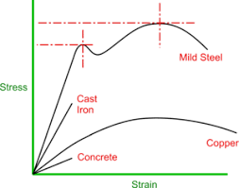
IGCSE Product Design
Material Properties
DESIGN

Slide 11
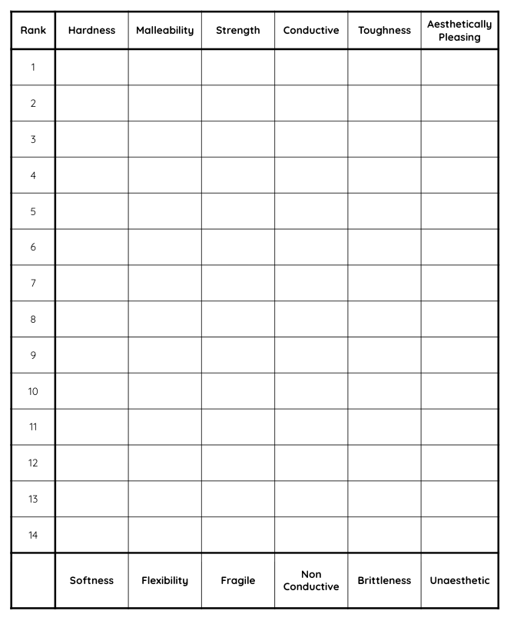
IGCSE Product Design
Material Properties
DESIGN
Material Properties
Create a test that you can perform on each sample of material to rank them in order of the given property.
Material List
Aluminium
Mild Steel
Copper
Stainless Steel
Balsa
Oak
Plywood
MDF
Pine
Acrylic
PVC
Polystyrene
Carbon fibre
PLA

